Slide 1
µCoaching
When goals become reality...
Filip Gulán, Jan Herec, Marek Marušic

Slide 2
App purpose and capabilities
App is platform for micro-coaching
Two app modes: performer and coach
Performer is pushed towards by coach (mostly his friend) to achieve his goal

Slide 3
Use cases

Slide 4
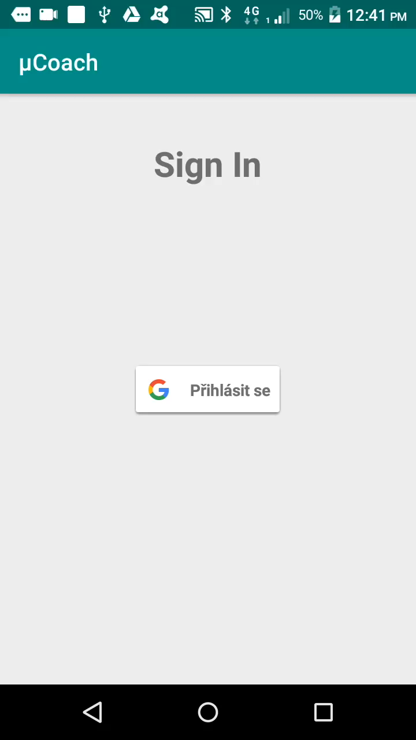
1: First app launching & goal creating
Notes:
Performer can create goal or edit created goal, so there is an Activity for this purpouse. In this Activity performer sets goal name, he can also set some milestones and really important is choosing a coach for that goal. On the left picture you can see situation when performer is creating new goal, on the right picture you can see situation when performer is editing goal, there is really one parameterizable Activity for both situations.

Slide 5
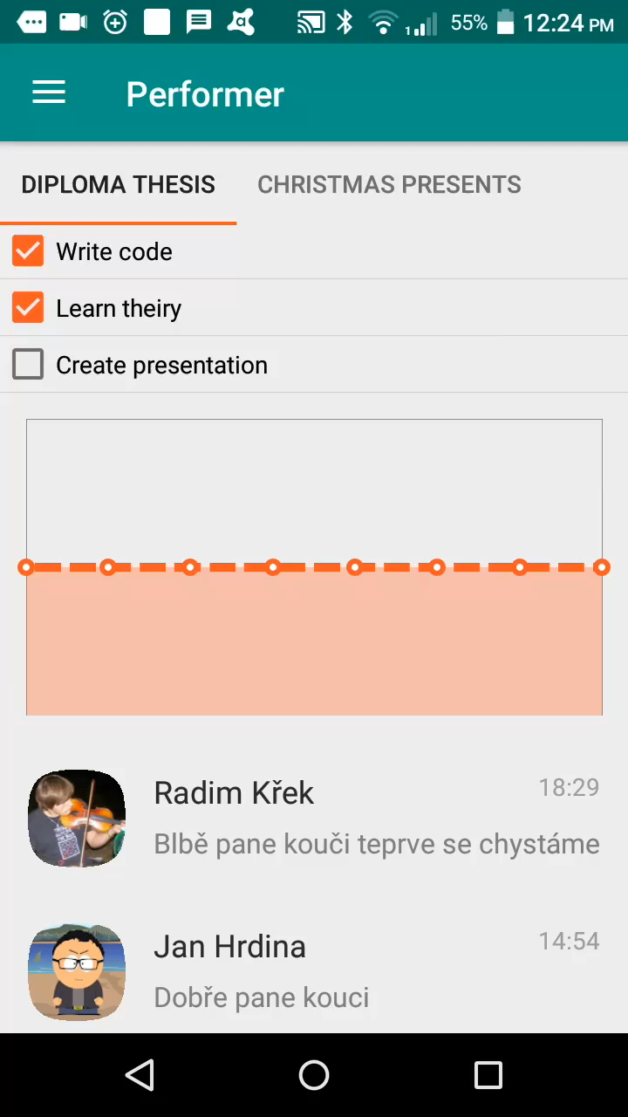
2: Performer mode capabilities
Notes:
Hello, let me introduce our selves and our app micro coaching.
Why this app?
Do you have some goals or dreams for example learn new language or progress with your diploma thesis ?
Are those dreams pushed out of your focus by some other “important” stuff like procrastination or you just forget about them for a long time?
Our app and your friend can help you to focus more and to get more motivation to accomplish your goals by micro - coaching.
You can create new goal and ask your friend to micro-coach you.
Your goals are shown in the performer screen where you can see your todos, grap with your progression and messages from your coach.
The progression is measured by the feeling you send to your coaches in the messages.

Slide 6
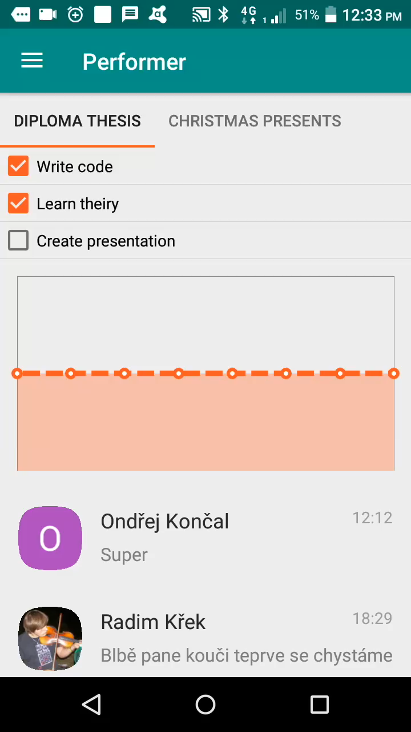
3: Coach mode capabilities
Notes:
Let’s look on the coach mode.
Coach can see the performance of the performer and of course can send him motivational messages to ask about the goal progression and performer’s feeling about his performance.
In case the coach is forgetful he can also set a reminder like “Ask Honza how is he doing on his goal?”. Every coach can create his own goals to perform.

Slide 7
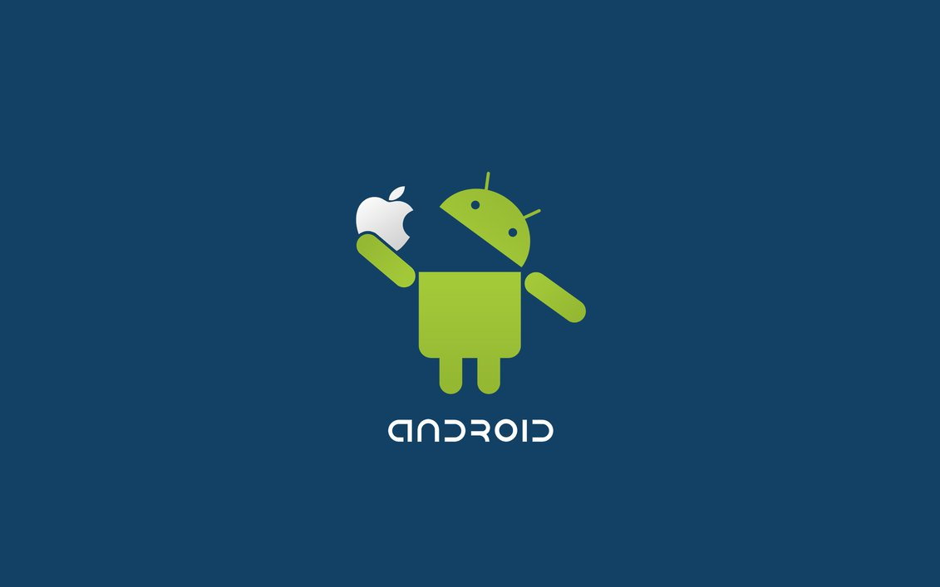
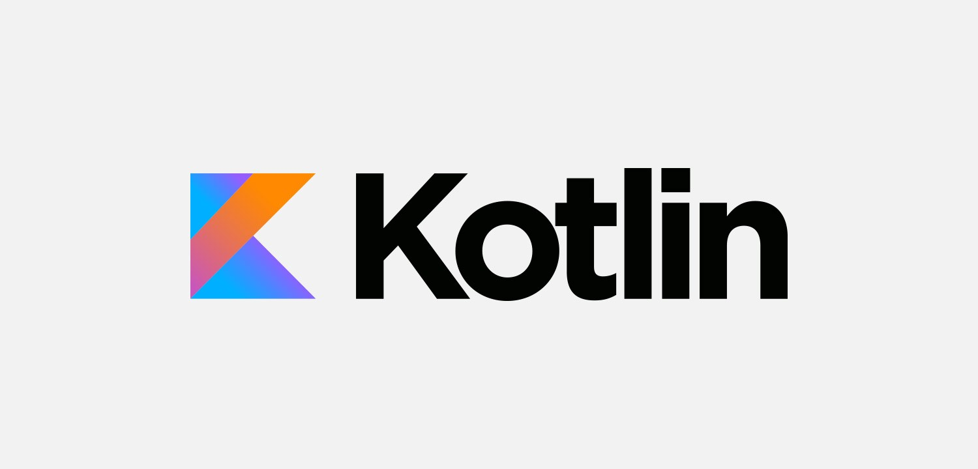
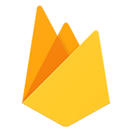
Technical background
Android
Kotlin
Firebase realtime database
data is stored as JSON and synchronized in realtime to every connected client

Slide 8
Gained experiences, what would we do differently
Teamwork really worked :-)
User evaluation - fixed bugs & adjusted design
Used technologies
Android - complicated app publishing process, annoying restrictions due Android’s obsession of saving battery
Kotlin - null safety, but missing promises functionality
Firebase - a lot different experience than the relational databases (json data modelling, asynchronicity - due missing promises in Kotlin we experienced real callback hell)
Maybe engaging another developer could help to achieve more goals.
Notes:
Teamwork - really worked, we are good friends in almost daily contact :-)
User evaluation - several users gave us feedback, so we fixed bugs and adjusted the design
Used technologies
Android - app publishing process is complicated, restrictions due Android’s obsession of saving battery are annoying
Kotlin - null safety, but missing promises functionality
Firebase - a lot different experience than the relational databases (json data modelling, asynchronicity - due missing promises in Kotlin we experienced real callback hell)
Despite the great deployment, it was not possible to achieve everything we wanted. It is question if engaging another developer could help...

Slide 9
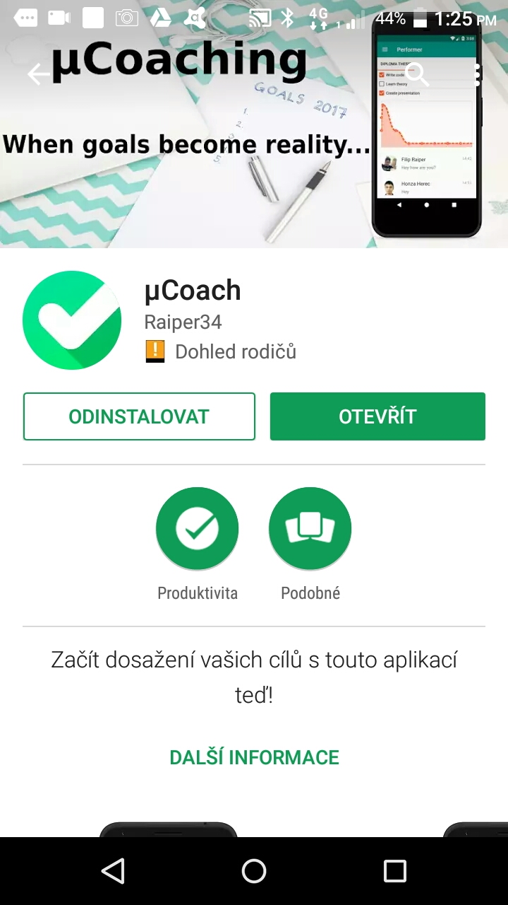
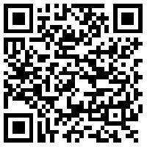
Where you can get this app?
On Google Play!
goo.gl/or6sh6
Not bug free yet!

